Slide 1
Employee Data Analysis using Excel
STUDENT NAME: N.Harini
REGISTER NO: 2213331042096
DEPARTMENT: Commerce
COLLEGE: Bharathi women's college

Slide 2
PROJECT TITLE
Employee Salary Analysis using Excel

Slide 3
AGENDA
Problem Statement
Project Overview
End Users
Our Solution and Proposition
Dataset Description
Modelling Approach
Results and Discussion
Conclusion
3/21/2024 Annual Review

Slide 4
PROBLEM STATEMENT
Analyze the salary data of employees to identify trends, disparities, and areas for improvement. The analysis should include metrics such as average salary, departmental salary distribution, total compensation, and correlation between salary and performance. The goal is to gain insights into salary structures, ensure fair compensation, and inform future salary decisions.

Slide 5
PROJECT OVERVIEW
The project aims to conduct a comprehensive analysis of employee salary data using Excel. This involves collecting and organizing salary-related information, calculating key metrics (such as average and total compensation), and analyzing salary distributions across departments and job titles. The project will also explore correlations between salary, performance, and other factors. The findings will be visualized using charts, pivot tables, and dashboards to provide actionable insights for optimizing compensation strategies and ensuring equity within the organization.
.

Slide 6
WHO ARE THE END USERS?
The end users of this analysis are HR professionals, department managers, and company executives who need insights to make informed decisions about employee compensation, salary adjustments, and overall workforce management.

Slide 7
OUR SOLUTION AND ITS VALUE PROPOSITION
Our Solution:
We provide a detailed salary analysis using Excel, offering insights into salary trends, disparities, and correlations with performance. This analysis enables data-driven decisions on compensation strategies.
value Proposition:
Our solution ensures fair and competitive compensation, helps identify areas for improvement, and supports informed decision-making, ultimately enhancing employee satisfaction and retention.

Slide 8
Dataset Description
The dataset includes employee information such as Employee ID, Name, Department, Position, Base Salary, Bonuses, Deductions, Net Salary, Hire Date, and Performance Rating. This data is used to analyze salary structures, identify trends, and assess compensation fairness across the organization.

Slide 9
THE "WOW" IN OUR SOLUTION
Our solution goes beyond basic salary analysis by integrating advanced Excel tools to uncover hidden trends, visualize disparities, and provide actionable insights. This empowers organizations to optimize their compensation strategies, ensuring fairness and boosting employee morale.
3/21/2024 Annual Review
9

Slide 10
MODELLING
We use Excel's functions, pivot tables, and charts to model salary data, calculating key metrics like average and total compensation. This allows us to segment data by department, position, and performance, enabling in-depth analysis and forecasting.
10

Slide 11
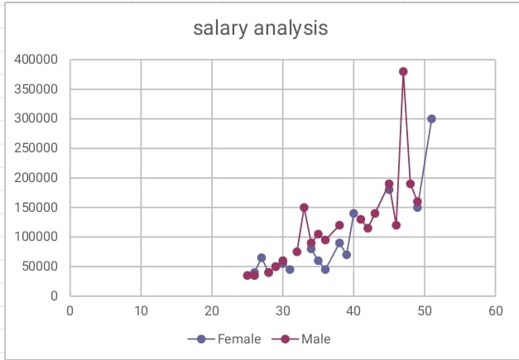
RESULTS
11

Slide 12
conclusion
This salary analysis provides critical insights into employee compensation, highlighting areas for adjustment and ensuring equitable pay. By leveraging these findings, organizations can make informed decisions that promote fairness, optimize salary structures, and enhance overall employee satisfaction and retention.

